Slide 1


Network Adequacy
Data Maintenance Planning
10:00 am-11:30 am Central
October 7, 2024
Regulatory Health Link Division,
Arkansas Insurance Dept., Dept. of Commerce

Slide 2
Agenda
Introductions & housekeeping.
Recap.
Change Summary.
Caution over APCD originated purges.

Slide 3
PTNP Data Maintenance
Why?
Industry agreement on the classification of individual providers and facilities, who treat Arkansans, into “Provider Types” defined by Arkansas.
This agreement is key to AID’s evidence-based Network Adequacy regulation.

Slide 4
PTNP Data Maintenance
Why?
Industry agreement on the classification of individual providers and facilities, who treat Arkansans, into “Provider Types” defined by Arkansas. required under CMS-CCIIO Time and Distance standards.
This agreement is key to AID’s evidence-based Network Adequacy regulation.

Slide 5
Agenda
Introductions & housekeeping.
Recap.
What will be published?
Federal Provider types.
Details on the initial “seed” template.
Timeline.
The challenge of the first review.
Questions.

Slide 6
Recap.
  CMS-CCIIO NA Time and Distance standards applicable PY2026
  AID decided to have one NA standard in the state thereby CMS-CCIIO NA Time and distance standards becomes applicable starting PY2026.
  Rule 106 will be amended as the Department works the kinks in the implementation
  With no Federal guidance on data governance for common understanding of provider classifications, the Department decided to keep it’s industry-collaborative data governance process running, but with entirely new data.
  Change from the existing Arkansas provider types to CMS-CCIIO provider-types with different definitions has created challenges and demands on the regulator-industry collaborative for common understanding of provider classifications.
  AID intended to participate in the Provider-Type-NPI-Pool (PTNP) process for the first time using the APCD and other analysis, just like any other issuer and expects to be subject to the voting process.

Slide 7
Timeline –
PTNP rounds & certification review
We are engaged in this round
Last round before we go live with CCIIO T&D stds
PTNP Round 2 of 2024
PTNP Round 1 of 2025
Certification Review for PY2026
mid-Aug, 2024
mid-Dec, 2024
mid-March, 2025
mid-May, 2025
Jan 1, 2026

Slide 8
PTNP Round 2 of 2024
(First cut of Federal Requirements)
Issuers & AID meet
Issuers & AID meet
Stage 1 (Issuers suggesting changes)
40 days
13 days
Stage 2 (Issuers voting)
42 days
28 days
8/15/2024-Initial template published
9/24/2024
Add/Delete Suggestions from Issuer
10/7/2024
Consolidated suggestions by AID
11/18/2024 Votes from Issuers
12/16/2024
Finalized PTNP by AID

Slide 9
PTNP Round 1 of 2025
(First cut of Federal Requirements)
Stage 1 (Issuers suggesting changes)
30 days
16 days
Stage 2 (Issuers voting)
28 days
14 days
12/16/2024-Initial template published
1/15/2025
Add/Delete Suggestions from Issuer
1/31/2025
Consolidated suggestions by AID
2/28/2025 Votes from Issuers
3/14/2025
Finalized PTNP by AID

Slide 10
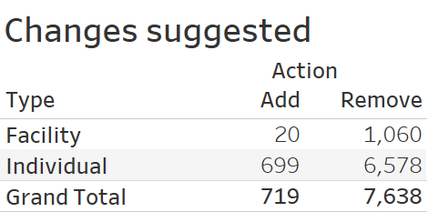

Slide 11
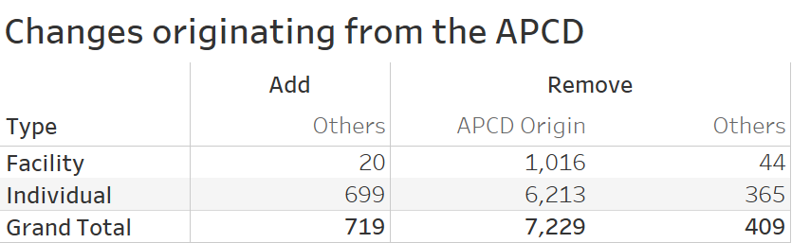

Slide 12
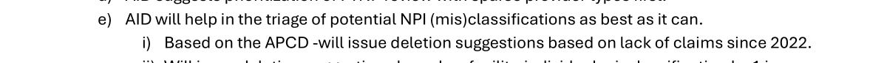
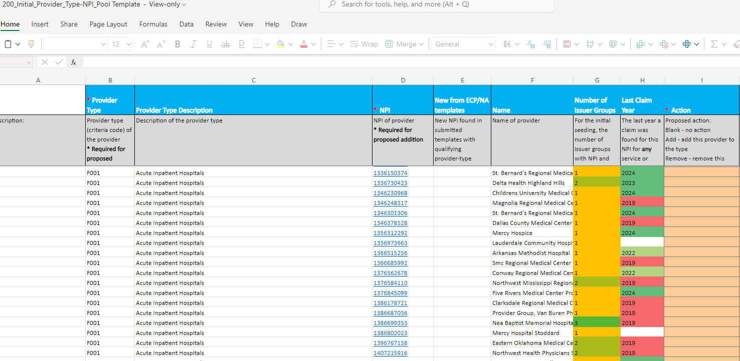
From the past meeting…

Slide 13
Urging caution over APCD based corrections
AID is urging caution against its own suggestion based on NPIs disappearing from the APCD in recent years.
Motivation behind Department’s effort to use the APCD was to make it easier on the issuers by shrinking the size of the PTNP list starting at 41K rows. Disappearing NPIs from APCD claims seemed reasonable to purge as outdated data.
The Department does not want to make things worse in its effort to help in the collaborative data maintenance program by suggesting this APCD based purge.
APCD based cleanup amounts to using billing systems to clean the Network systems. The Department urges issuers to consult with experts who have understanding of both, the billing and network systems if the APCD based cleanup is a good idea in the first place, and accordingly vote.
Lastly, with our limited APCD experience, data teased out from the APCD should NOT be accepted without some vetting.

Slide 14


Discussions & Questions
Email
RHLD.DataOversight@arkansas.gov

Slide 15
Appendix
Additional Reference slides

Slide 16
Errors to avoid during Stage 1: “Suggestions for change” (1 of 3)
Please understand that PTNP data maintenance is NOT just about your network(s) alone. DO not attempt to remove a provider who is not in your network anymore but may work for others.
Please understand that our PTNP data maintenance attempts to focus on actual provider practice rather than academic qualifications. For example, a provider who is qualified in “Internal Medicine” but is known to work only in the ER of a hospital, should not be classified as a Primary Care Provider.
Please remember we are communicating about correcting classifications of NPIs (i.e. Providers). Not whether a NPI (i.e. Provider) exists. Each line communicates either addition of an NPI to a “C-bucket” –OR- removal of an NPI from a “C-bucket”.
A misclassified NPI *may* require two or more suggestions. One would be a removal from the incorrect “C-bucket” and if not already assigned to the applicable “C-bucket(s)”, addition(s) to the correct “C-bucket(s)”. Sometimes a misclassification may require only one suggestion- a removal from a “C-bucket” with no concomitant addition suggestions, since an appropriate “C-bucket” does not exist for the NPI.
Try not to approach the PTNP data maintenance with an inclination towards one type of action (say an inclination towards either addition or deletion). AID tends to compare competitor networks before issuing an objection. Just focusing on say additions and not on removal of inaccurate NPI classifications may not help you in AID’s comparative analysis. Please approach the PTNP data maintenance as an effort towards accurate classification.
While adding bordering state providers, please remember that AID does not have any “contiguous county” requirement. But bear in mind though that adding providers very far from the borders may not help with your average distance calculations. Add providers in bordering states that Arkansans do avail – because your consumers are probably the best judge.

Slide 17
Errors to avoid during Stage 1: “Suggestions for change” (2 of 3)
While removing a misclassification for a provider be careful not to remove other classification for the same NPI that may be correct.
  For instance while cleaning up misclassified Endocrinologist NPIs, AID observed issuers removing correct association of those NPIs with Oncology.
While adding a NPI to a “C-bucket”, please pay heed to the taxonomic definition of the “C-bucket”. Same consideration applies when looking for removals.
  For instance the current definition of C250 (Access to Dental – General) does not include Pediatric Dentists, so do not add them to “Dental General”. Conversely if you know an NPI listed in “Dental – General” is an Pediatric Dentist by practice, ask for its removal.
Do provide your most compelling reason for an addition or deletion. Each issuer’s reasons behind an addition or removal is shown to all issuers during the voting round and may influence their feedback. During vote processing AID may overrule the direction of a vote based on the strength of an issuer’s reason.
  An example of a compelling reason for removal of a PCP can be a brief “Works only in emergency medicine in our 2016 claims data”.
Download and use the correct template to suggest changes. Please do not fashion your own spreadsheet.
AID had observed significant feedback in the voting stage (that comes later) saying that a particular NPI should belong to some other bucket. Please understand that the “Suggestions for change” stage is the stage to add or remove from an classification. The voting stage that comes later, is not the place to make addition or removal suggestions.

Slide 18
Errors to avoid during Stage 1: “Suggestions for change” (3 of 3)
When a facility changes ownership, it gets a new NPI. When adding this NPI remember to delete the NPI associated with the previous owner.
Before adding an NPI to a provider bucket, ensure that the NPI does not already exist in that bucket.
Remember – we are doing this data maintenance because the NPI Registry does not have the adequate data quality for provider classifications. Therefore, do not be quick to re-classify a provider existing in the PTNP final list solely based on the taxonomy in the NPI Registry

Slide 19
Errors to avoid during Stage 2:
“Voting” stage (1 of 1)
Most network data considerations during the “add-remove” stage also apply to the “Voting” stage; Taxonomic definitions, Out-of-state provider distance considerations, etc. should be considered.
  For example, before objecting to some other issuer’s removal of an apparently valid NPI-”C bucket” combination, consider if the provider is out of state, and if all practicing locations are far from the border.
Please use the recommended template.
Please remember that this stage is only to communicate your agreement or rejection of a suggested change of provider classification. It is not about communicating whether a NPI (i.e. Provider) exists – or – that the provider is miss-classified and should belong to a different bucket. While rejecting an addition suggestion, if you realize that the NPI belongs to a different C-bucket, your opportunity for suggesting the addition to the appropriate C-bucket(s) will be in future PTNP data maintenance rounds. Suggestion to add to a different C-bucket cannot be handled at this stage.
Do provide your most compelling reason behind rejecting an addition or deletion. AID may use the strength of your reason to settle a tie, or even reverse the direction of a vote.
  An example of a compelling reason for rejecting addition of a NPI as a PCP can be a terse “Works only in emergency rooms per claims data”.

